Slide 1
Parenting Styles By Diana Baumrind
Baumrind is a clinical and developmental psychologist and is known for her research on parenting styles.
Baumrind concluded parenting styles differed in four different dimensions:
parents' warmth/nurturance
discipline strategy
communication skills
expectations of maturity

Slide 2
Why is Understanding Parenting Styles Important?
Research over many years has confirmed over and over that parenting style has a direct effect on how children grow and thrive.
Parenting styles account for the way children functioned socially, emotionally and cognitively in the world.

Slide 3
The Four Different Parenting Styles
Authoritative
Permissive
Uninvolved
Authoritarian

Slide 4
Permissive Parenting Style
Parents take on the role of "friends.“
Do not have any expectations of child.
Free from rules and discipline.
They allow the child to make their own decisions.
Not taught what is right or wrong
How does it affect children as they grow older:
More problem behaviors.
Less likely to do well in school.
Difficulty regulating themselves.
Notes:
What you come out with is a child that has no discipline, no sense of right and wrong, and spoiled as all hell. When these children grow up, they’re never taught what is right and what is wrong, so they keep their “I deserve everything I want attitude” as they mature. They have simply never had to regulate themselves before, and although children can grow up and learn these things on their own, it’s not very likely.

Slide 5
While shopping, your six-year-old son begs for a bag of chips(even though it is almost dinner time). You say:
A. "Not a chance. You should know better than to ask me for one right before we have dinner."
B. "OK, you've been such a good boy, you deserve a bag of chips." He seems to have his heart set and, after all, it's only one bag of chips.
C."No, you’ve already had plenty of snacks – pick something healthy instead."
D. "Don’t nag me. What I spend my money on is up to me."

Slide 6
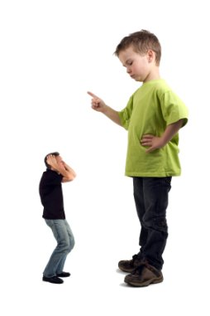
B. "OK, you've been such a good boy, you deserve a bag of chips." He seems to have his heart set and, after all, it's only one bag of chips.

Slide 7
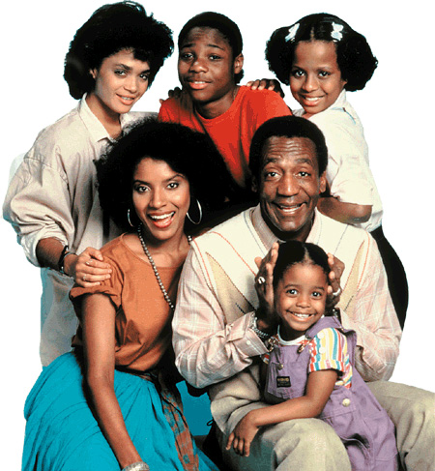
Authoritative Parenting Style
Democratic style of parenting.
Parents are attentive and forgiving.
Teach their offspring proper behavior.
Have a set of rules, and if child fails to follow there is a consequence.
How does it affect children as they grow older:
Demonstrate social and academic competence.
Less likely to have problem behaviors.
High self-esteem.
Demonstrates leadership qualities.
Fewer mental health problems.

Slide 8
On a rainy day, your 11-year-old son begs not to go to his track meet because it’s rainy and he really really really really doesn’t want to go. On the one hand, it’s not schoolwork. On the other hand, you’ve noticed that lately your son is spending more time “hanging out,” not really using his time well, saying he’s too sick for school when you don’t agree, and basically avoiding anything that requires uncomfortable effort. In response, you:
A. say, "It's up to you what you choose to do. Besides, it's only track — it's OK if once in awhile you miss it."
B. Offer to pick him up early from school and take him out for ice cream since you know he’s been tired out lately and needs a break.
C. say, "I understand you don't want to go and I know that feeling of not doing something you don't want to, but that's precisely why I want you to go. Sometimes we have an urge to avoid tough stuff, but it’s important to do things even when they're hard."
D. say, "You have to go. No ifs, ands, or buts - conversation over."

Slide 9
C. Say, "I understand you don't want to go and I know that feeling of not doing something you don't want to, but that's precisely why I want you to go. Sometimes we have an urge to avoid tough stuff, but it’s important to do things even when they're hard."

Slide 10
Uninvolved Parenting Style
Parents neglect their child by putting their own life before the child's.
They do provide for the child's basic needs but they show little interaction with the child.
Discipline is marked by inconsistency with punishments ranging from no action to extreme action.
How does it affect children as they grow older:
Lowest test scores from all styles.
Highest rates of poverty, depression, school dropout, unemployment, and incarceration.
Have negative attention seeking behavior.
Low self-esteem.
Notes:
The child either grows up too quickly, needing to take care of himself since the parent isn’t present, or not at all, remaining immature and helpless. They often have behavioral issues in school, do worse academically, and remain socially and emotionally isolated.
When they grow up, they are more likely to have severe behavioral and mental problems. Their want of personal relationships makes them easily manipulated by others.

Slide 11
You and your daughter have been doing errands all Sunday and you both come home tired and cranky. Your daughter has homework and she announces she needs lots of help, despite your throbbing headache. You say:
A. "I will help you, but get started on it on your own and do what you can."
B. "It's not my homework. You have to do it on your own. And make sure you do a good job or there will be punishments."
C. "Why don't I do your homework with you?"
D. "I have such a headache. Please do it on your own or just skip it tonight. After all, it's been a long day and I know how tired you are."

Slide 12
D. "I have such a headache. Please do it on your own or just skip it tonight. After all, it's been a long day and I know how tired you are."

Slide 13
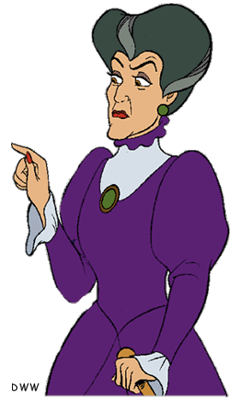
Authoritarian Parenting Style
Strict parenting style, involves high expectations from parents but have little communication between child and parents.
Parents don't provide logical reasoning for rules and limits, and are prone to harsh punishments.
How does it affect children as they grow older:
Perform moderately well in school.
Poorer social skills.
Lower self-esteem.
Higher levels of depression.
Girls are raised to be less independent,
and boys are more aggressive.
Notes:
Authoritarian parenting will either produce children that are overly obedient and proficient, or on the flip end, children that refuse to acknowledge authority and maybe even become delinquent. In the second case, parents make their children the opposite of what they intend: In wanting their children to succeed, they push them too hard and impose too many limitations on them, making the children less likely to succeed

Slide 14
Your teenage children have been asking to go to a party at the home of a kid you’d rather they not socialize with. After telling them you don’t want them to go, they launch a full assault with tears and arguments that all their friends are going and that you’re the strictest parent in the whole world. In response you:
A. say, "OK, fine, you can go. But don't expect me to help you get there. You have to find your own ride."
B. ground them for talking back to you and questioning your judgment.
C. say, "I want to sit down and talk to hear your concerns, but I'm not going to change my mind as long as I feel the party won't be a safe place."
D. realize they have a point – they should be able to go to a party all their friends are attending. You even offer to take them to the party, but because you're concerned about safety, you wait in a nearby café and pick them up at the end of the night.

Slide 15
B. Ground them for talking back to you and questioning your judgment.

Slide 16
Which one is considered the best parenting style and why?

